Slide 1
Classification of Microorganism
Microorganisms are classified on several basis;
1.On the basis of cell types:-
According to this, microorganisms are classified as Prokaryotes and Eukaryotes.
2.On the basis of system (kingdom)
According to this, living things are classified into 5 kingdom;
Monera: it includes unicellular prokaryotic organisms. Ex: bacteria, blue green algae.
Protista: it includes unicellular and eukaryotic organisms. Ex : Protozoa, Amoeba.
Fungi: it includes mostly multicellular, unicellular eukaryotic and heterotrophic organisms. Ex: molds, yeasts
Plantae: it includes multicellular eukaryotic and autotrophic organisms. Ex: green plants.
Animalia: it includes multicellular animals.

Slide 2
3.On the basis of 3 domain system:-
Archaea:-include the microorganisms that have ability grow under harsh conditions.
Eubacteria:- true bacteria growing in normal habitat.
Eukarya:- include 4 remaining kingdoms of Whittaker.

Slide 3
4. On the basis of groups
According to this, microorganisms are classified as;
Bacteria: they are unicellular minute organisms and includes cyanobacteria, true bacteria, actinomycetes etc.
Virus: they are unicellular, ultramicroscopic obligate intracellular parasites.
Fungi: they are unicellular as well as multicellular eukaryotic organisms.
Protozoa: these are eukaryotic multicellular cells.
Mycoplasma: these are prokaryotes that differ from bacteria. They are small, simple but lacks cell wall so they have pleomorphic structure.
Rickettsiae and chlamydiae: they are strict intracellular, short rod shaped gram negative organisms.

Slide 4
Bacteria

Slide 5
Bacteria
Bacteria form a large group of prokaryotic unicellular parasitic, saprophytic and free-living microorganisms, varying in size from 0.1–10 µm long.Microscopic.They have a simple cell structure, contain both deoxyribonucleic acid (DNA) and ribonucleic acid (RNA), and multiply by binary fission. They are classified by their morphology, staining reactions, cultural characteristics, biochemical reactions, antigenic structure, and increasingly by their genetic composition using specialized molecular biology techniques.

Slide 6
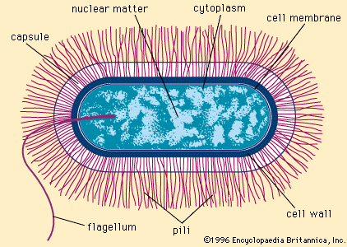

Slide 7
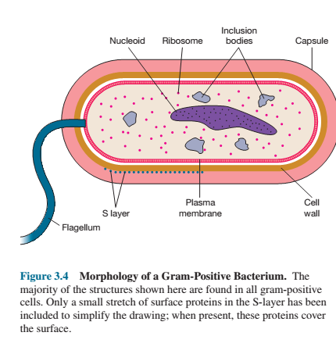

Slide 8
Bacterial structure
Bacteria are the microscopic organisms and have the complex structure. Some structures are necessary for the growth and survival and some for motility and to cause disease.

Slide 9
The major structures of a typical bacteria are explained as :
Structure external to cell wall
Cell wall
Structure internal to cell wall
Endospores

Slide 10
Structure external to cell wall
Flagella
Pili (fimbriae)
Cell envelops
Slayer

Slide 11
Structures internal to the cell wall
Cytoplasmic membrane
Cytoplasm:
cytosol and other structures(ribosome, inclusion bodies, nucleoid, plasmids)

Slide 12
Flagella
Plural flagella (s., flagellum),
Hollow filament composed of long, rigid and helical strand of protein flagellin.
It is locomotor appendages extending outward from the plasma membrane and cell wall.
About 20 nm across and up to 15 or 20 µm long.
Flagella are thin, can be observed by special staining techniques .The detailed structure of a flagellum can only be seen in the electron microscope.
Posses filament. Hook and basal body.

Slide 13
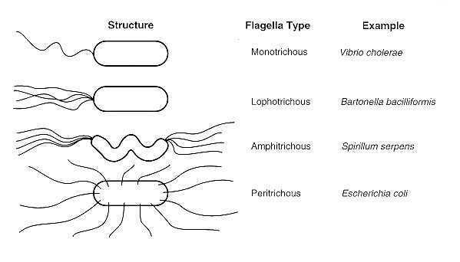

Slide 14
Flagellar Ultrastructure
Bacterial flagellum is composed of three parts.
Filament,
Hook,
Basal body
Filament: The longest and most obvious portion is the filament, which extends from the cell surface to the tip. The filament is a hollow, rigid cylinder constructed of a single protein called flagellin, which ranges in molecular weight from 30,000 to 60,000. The filament ends with a capping protein. Some bacteria have sheaths surrounding their flagella. For example Vibrio cholerae has a lipopolysaccharide sheath

Slide 15
Flagellar Ultrastructure
Bacterial flagellum is composed of three parts.
Filament,
Hook,
Basal body
Filament: The longest and most obvious portion is the filament, which extends from the cell surface to the tip. The filament is a hollow, rigid cylinder constructed of a single protein called flagellin, which ranges in molecular weight from 30,000 to 60,000.

Slide 16
Hook:
Slightly wider than the filament, the hook is
made of different protein subunits. Hook is a molecular universal joint that attaches the filament and the basal body. The hook is flexible, allowing the angle between the filament and the bacterial cell surface to change over a wide range
Basal body(Motor)
Is the most complex part of a flagellum and embedded in the cell surface and contains a motor that turns the helical flagellum to drive the cell through a liquid environment similar as a propeller drives a boat.

Slide 17
Basal body varies depending on bacterial cell wall structure
Gram-negative bacteria have 4 such rings:
L ring associates with the lipopolysaccharides,
P ring associates with peptidoglycan layer,
M ring is embedded in the plasma membrane
S ring is exposed to the periplasmic space
Gram-positive bacteria have only two rings:
M ring an inner ring connected to the plasma membrane and
S ring an outer one attached to the peptidoglycan.

Slide 18
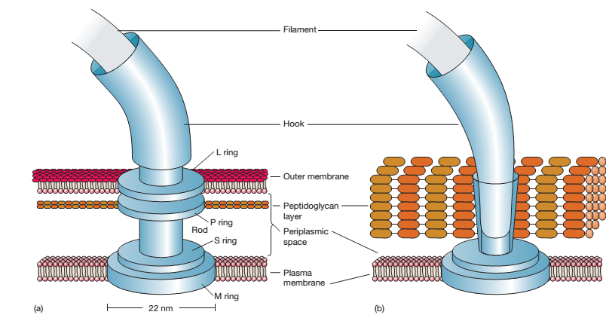

Slide 19
Advantages of Flagella
Motility
Chemotaxis
Medical Importance of Flagella
1. Role in Pathogenesis:
E.coli and Proteus spp are common causes of Urinary tract infections. The flagella of these bacteria help the bacteria by propelling up the urethra into the bladder.
In some diseases like cholera, flagella enable the bacilli to move among the tissue and escape phagocytosis by white blood cell.
2. Roles in Organism identification
Some species of bacteria, eg. Salmonella species are identified in the cilinical laboratory by the use of Specific antibodies against flagellar proteins.
Organisms such as Vibrio cholerae (darting motility) and Proteus species (swarming growth in common culture media) are easily identified by their characteristics motility pattern.

Slide 20
Pili and Fimbriae
Short, fine, hair like numerous appendages(up to 1,000) that are thinner and shorter than flagella.
Do not involved in motility.
They are only visible in an electron microscope due to their small size.
composed protein subunits called pillin.
Antigenic structure

Slide 21
Functions
Attachment of bacteria to solid surfaces such as rocks in streams and host tissues.
(Helps in colonization and cause disease).
Helps in transfer of genetic material by conjugation.Sex pilus.

Slide 22
Cell envelops
Glycocalyx. adhering layer extending from the cell wall of bacteria.
It encompass capsules and slime layers.
When the layer is well organized, thick, tightly bound and not easily washed off, it is called a capsule.
When layer thinner, diffuse, unorganized, less tightly bound and easily removed, called as slime layer.(Streptococcus mutans, Alcaligen viscolactis)

Slide 23
Advantages of capsules
Prevent bacteria from drying
Acts as antiphagocytic
It acts as antigen
Block the attachment by bacteriophage
Helps in attachment

Slide 24
Advantages Slime layer
Slime layer helps bacteria to attach on surface and form biofilm
Biofilm shield bacteria from body’s immune defenses, antibiotics and other therapies.
Slime helps some bacteria in their motility esp. in gliding bacteria.

Slide 25
S- layer
The S-layer is the regularly structured like floor tiles on the surface of bacteria.
Is composed of protein or glycoprotein .
Both gram-positive and gram-negative bacteria have a S-layer on their surface.
In gram-negative bacteria the S-layer adheres directly to the outer membrane;
In gram positive it adheres with the peptidoglycan surface.
S- layers are also very common among Archaea.

Slide 26
Functions
It protect the cell against ion and pH fluctuations, osmotic pressure, enzymes, and the predator bacterium Bdellovibrio (prey on gram –ve bacteria)
The S-layer also helps maintain the shape and envelope rigidity in some bacterial cells.
It can promote cell adhesion to surfaces.
Protects against complement attack and phagocytosis, thus contributing virulence to bacteria

Slide 27
Cell wall
The cell wall is the rigid layer, usually lies just outside the plasma membrane.
Eubacterial cell wall markedly differ from other microorganisms and plants in containing the network of peptidoglycan chains.
This is a large molecule, also called as murein, is composed of alternating units of two amino-containing sugars, N-acetylglucosamine(NAG) and N-acetylmuramic acid(NAM) connected by side chains of four amino acid and peptide cross bridge

Slide 28
There are two predominant types of bacterial cell wall, which provides the means to identify stained bacteria as gram positive and gram negative

Slide 29
Gram positive cell wall
Peptidoglycan
Teichoic acid
(Periplasmic space or periplasm)

Slide 30
About 60-90 % of cell wall is peptidoglycan layers.
It is an insoluble, porous cross link polymer of enermous strength and rigidity.
The peptidoglycan contains anionic polysaccharide teichoic acids (polymers of glycerol or ribitol joined by phosphate groups, negatively charged and confer negative charge to cell wall).
The teichoic acid helps to link the peptidoglycan together.

Slide 31
The teichoic acids are connected to either the peptidoglycan itself by a covalent bond or to plasma membrane lipids; in this case called as lipoteichoic acids.
The functions of these molecules are still unclear, but they may be important in maintaining the structure of the wall, binds with magnesium and form pool of cations within cytoplasm and confers stabilization.
Teichoic acids are not present in gram-negative bacteria.

Slide 32
Periplasmic space:-
A space between the plasma membrane and the peptidoglycan layer of most gram negative bacteria, and sometimes a similar but smaller gap(or absence) may be observed between the plasma membrane and wall in gram positive bacteria.
The periplasmic space may be filled with a loose network of peptidoglycan. Possibly it is more a gel than a fluid-filled space.
In gram positive:
They secrete several enzymes. Such secreted enzymes are often called exoenzymes. Some enzymes remain in the periplasm and are attached to the plasma membrane.

Slide 33
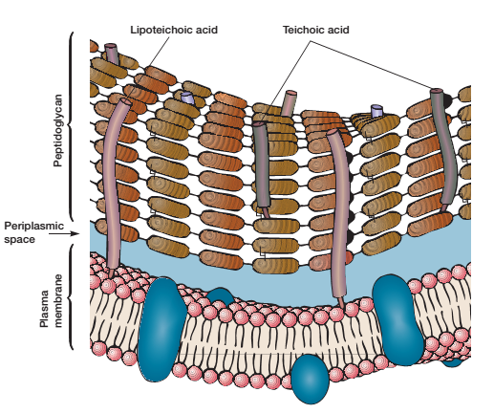

Slide 34
Gram-Negative Cell Walls
Much more complex than gram-positive walls.
Peptidoglycan
Outermembrane
Periplasmic membrane

Slide 35
The outer membrane lies outside the thin peptidoglycan layer.
It’s another structure that may strengthen the gram-negative wall.
It is compose of protein, carbohydrate and lipid.
It is bilayer and consist of inner layer phospholipid and outer layer lipopolysaccharides (LPS)
It also consist of porin and Braun’s lipoprotein.

Slide 36
Peptidoglycan:
The thin peptidoglycan layer present next to the plasma membrane.
In E. coli it is about 2 nm thick and contains only one or two layers or sheets of peptidoglycan.

Slide 37
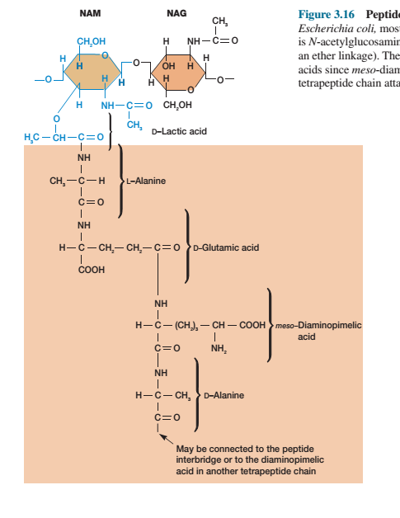
The peptidoglycan subunit of Escherichia coli,

Slide 38
Peptidoglycan composition and structure
Based on protein type and bonding the peptidoglycan differ in gram –ve and gram +ve bacteria.

Slide 39
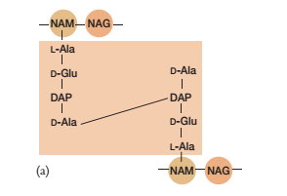
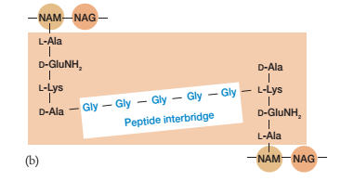
E. coli peptidoglycan with direct cross-linking, typical of many gram-negative bacteria
Staphylococcus aureus peptidoglycan posessing peptide interbridge

Slide 40
Lipopolysaccharides (LPS):-
large, complex molecules composed of both lipid and carbohydrate, and consist.
LPS contributes to the negative charge on the bacterial surface.
LPS helps stabilize membrane structure.
of three parts:
lipid A,
the core polysaccharide,
and the O side chain.
Lipid A is a major constituent and often is toxic; as a result the LPS can act as an endotoxin and cause some of the symptoms that arise in gram-negative bacterial infections.
The core polysaccharideis joined to lipid A.
The O side chain or O antigen(somatic) is a polysaccharide chain extending outward from the core.

Slide 41
Porin:
Three porin molecules cluster together narrow channel in outer membrane.Through which molecules smaller than about 600 to 700 daltons can pass.
Braun’s Lipoprotein:
A small lipoprotein covalently joined to the underlying peptidoglycan and embedded in the outer membrane by its hydrophobic end. It firmly linked outer membrane and peptidoglycan so they can be isolated as one unit.

Slide 42
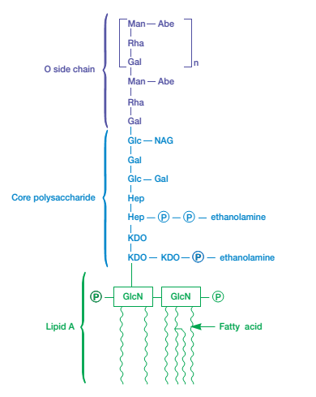
Abbreviations: Abe, abequose; Gal, galactose; Glc, glucose;
GlcN, glucosamine; Hep, heptulose; KDO, 2-keto-3-deoxyoctonate; Man, mannose; NAG,N-acetylglucosamine;
P, phosphate; Rha,L-rhamnose.

Slide 43
Functions of outer membrane:
A most important function is to serve as a protective barrier. It prevents or slows the entry of bile salts, antibiotics, and other toxic substances that might kill or injure the bacterium.
It is more permeable than the plasma membrane and permits the passage of small molecules like glucose and other monosaccharides.

Slide 44
Periplasmic space
Functions in gram –ve bacteria:-
The periplasmic space contains many proteins that participate in nutrient acquisition—
example,
hydrolytic enzymes attacking nucleic acids and
phosphorylated molecules, and binding proteins involved in transport of materials into the cell.
Denitrifying and chemolithoautotrophic bacteria often have electron transport proteins in their periplasm.
The periplasmic space also contains enzymes involved in peptidoglycan synthesis and the modification of toxic compounds that could harm the cell.

Slide 45
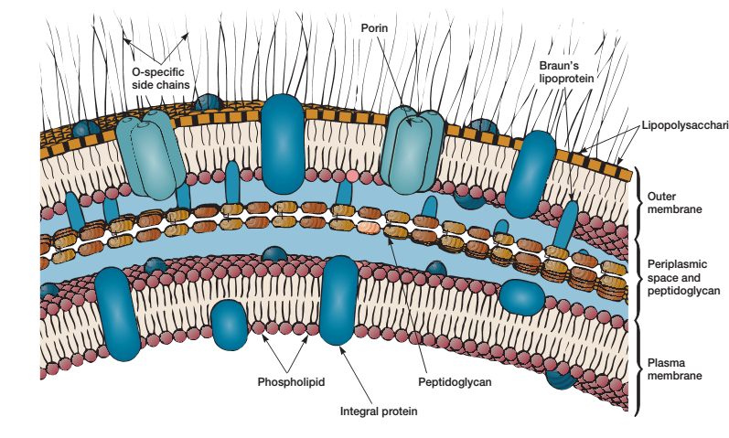

Slide 46
Function of cell wall
Give them shape and protect them from osmotic lysis wall shape and strength is primarily due to peptidoglycan.
The cell walls of many pathogens have components that contribute to their pathogenicity.
The wall can protect a cell from toxic substances and is the site of action of several antibiotics

Slide 47
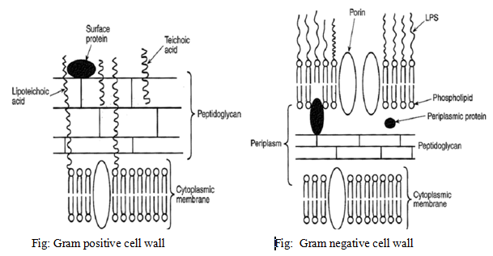

Slide 48
Function of cell wall
Give them shape and protect them from osmotic lysis wall shape and strength is primarily due to peptidoglycan.
The cell walls of many pathogens have components that contribute to their pathogenicity.
The wall can protect a cell from toxic substances and is the site of action of several antibiotics

Slide 49
Cytoplasmic membrane
The cytoplasmic (plasma) membrane is a thin structure lying inside the cell wall and enclosing the cytoplasm of the cell .
The plasma membrane of prokaryotes consists primarily of phospholipids (most abundant chemicals )in the membrane, and proteins.
They lack sterols, hence prokaryotic plasma membranes are less rigid than eukaryotic membranes.
Phospholipid and protein are not cemented in one place but they move laterally in the membrane surface hence this dynamic model of membrane structure is called the fluid mosaic model.

Slide 50
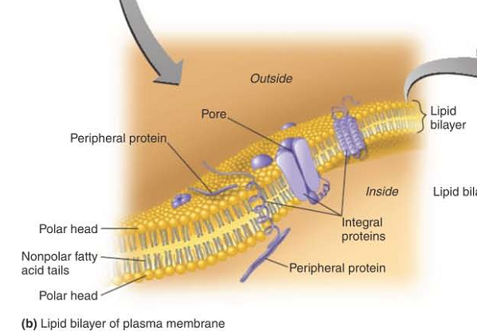

Slide 51
Phospholipid:-
The phospholipid molecules are arranged in two parallel rows, called a lipid bilayer
Each phospholipid molecule contains a polar head, composed of a phosphate group and glycerol that is hydrophilic (water-loving) and soluble in water, and nonpolar tails, composed of fatty acids that are hydrophobic (water-fearing) and insoluble in water.
The polar heads are on surfaces of the lipid bilayer, and the nonpolar tails are in the interior of the bilayer.

Slide 52
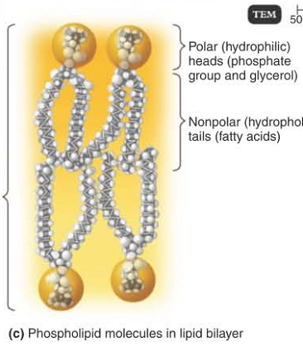

Slide 53
Proteins:-
The major protein of cytoplasmic membrane have hydrophobic surface in their regionsthat span the membrane an hydrophobic that contacts environment and cytoplasm
The protein molecules in the membrane can be arranged in a variety of ways:-
Some, called peripheral proteins, are easily removed from the membrane by mild treatments and lie at the surface of the membrane. They may function as enzymes that catalyze chemical reactions, as a "scaffold" for support, bind the substarte or process large molecules for transport, inner side of protein involved in the energy yielding reactions and as mediators of changes in membrane shape during movement.
Other called integral proteins:- can be removed from the membrane only after disrupting the lipid bilayer (by using detergents, for example).i.e proteins firmly embedded in membrane. Most integral proteins penetrate the membrane completely and are called transmembrane proteins. Some integral proteins are channels that have a pore, or hole, through which substances enter and exit the cell.

Slide 54
Many proteins acts as transporter proteins.
Provides hydrophilic channels or passages ways for ions and polar molecules to pass through.
Two types of transporter proteins like:-
Channel protein and carrier protein. Each transporter protein are specific for particular ions or molecules. So molecules that enter or pass out can be controlled.

Slide 55
Many of the proteins and some of the lipids on the outer surface of the plasma membrane have carbohydrates attached to them.
Proteins attached to carbohydrates are called glycoproteins.
Lipids attached to carbohydrates are called glycolipids.
Both glycoproteins and glycolipids protect and lubricate the cell and are involved in cell-to-cell interactions.

Slide 56
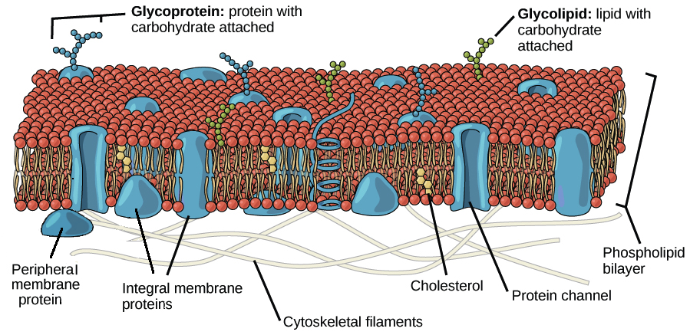

Slide 57
Functions
The most important function of the plasma membrane is to serve as a selective barrier through which materials enter and exit the cell.
Cytoplasmic membranes are also important to the breakdown of nutrients and the production of energy. The plasma membranes of bacteria contain enzymes capable of catalyzing the chemical.
In some bacteria, pigments and enzymes involved in photosynthesis are found in foldings of the plasma membrane that extend into the cytoplasm. These membranous structures are called chromatophores or thylakoids

Slide 58
Mesosomes
When viewed with an electron microscope, bacterial plasma membranes often appear to contain one or more large, irregular folds called mesosomes.
However, it is now known that they are artifacts, not true cell structures. Mesosomes are believed to be folds in the plasma membrane that develop by the process used for preparing specimens for electron microscopy.

Slide 59
Cytoplasm
Cytoplasm is the foundation substance of the cell and the centre of cell growth and metabolism
thick, aqueous, semitransparent.
Composed of about 80% water,
The major structures in the cytoplasm:-
Cytosol
Other structures(ribosome, inclusion bodies, nucleoid, plasmids)

Slide 60
Cytosol
A gelatinous mass of protein, amino acids, sugars, nucleoids, salts, vitamins and ions all dissolved in water.

Slide 61
Nucleoid
The chromosome region in bacterial cell is termed the nucleoid. It does not contain membrane and histone.
The nucleoid can be spherical, elongated, or dumbbell-shaped.
Contains a single long, continuous and frequently circularly arranged thread of double-stranded DNA that contains hereditary information or genes.
Depending on bacterial species, upto 3,500 genes may be present on the chromosome.

Slide 62
Plasmids
Bacteria often contain small, non essential usually circular, double-stranded DNA molecules called plasmids.
Exist apart from nucleoid and replicate independently of chromosomal DNA.
Usually contain 5 to 100 genes.
Plasmid are important in disease process. Some plasmids posses genes for toxic substances and drug resistance.

Slide 63
Ribosomes
It is one of the universal cell structure.
There are hundreds of thousand of ribosomes which gives granular appearance when viewed with the electron.
It is made up of protein and RNA.
They are called 70S ribosomes, and are constructed of a 50S and a 30S subunit.
They are the site of protein synthesis.

Slide 64
Inclusion bodies
Inclusion bodies are the cytoplasmic structure present in bacteria.
These bodies store nutrients or monomers for bacterial structures.
They can consist of aggregates or granules of polysaccharides(glycogen), elemental sulfur or lipid.
They serve as a basis for identification.

Slide 65
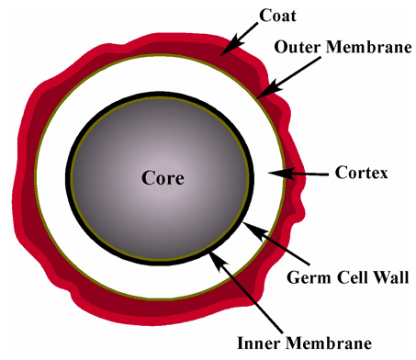
Endospores
Spores are highly resistant dormant structure produced by a number of gram positive bacteria like Clostridium species, Bacillus species etc.

Slide 66
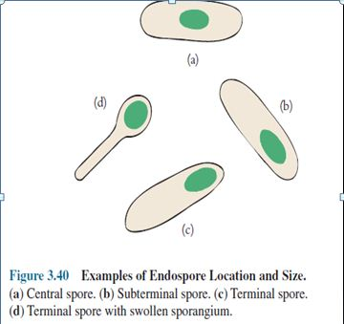

Slide 67
Bacteria form a large group of unicellular parasitic, saprophytic and free-living microorganisms, varying in size from 0.1–10 µm long. They have a simple cell structure, contain both deoxyribonucleic acid (DNA) and ribonucleic acid (RNA), and multiply by binary fission. They are classified by their morphology, staining reactions, cultural characteristics, biochemical reactions, antigenic structure, and increasingly by their genetic composition using specialized molecular biology techniques.

Slide 68
Classification of bacteria

Slide 69
1. On the basis of gram reaction
Gram staining is a differential staining technique that differentiate bacteria into gram positive and gram negative bacteria.
Other bacteria like Mycobacterium tuberculosis are stained by ZN staining.
The difference in gram staining is due to the differences between cell wall structure of gram positive and gram negative bacteria.
Knowing whether a disease-causing bacterium is Gram positive or Gram negative helps a physician to prescribe the appropriate antibiotic.

Slide 70
Some medically important group of bacteria
Gram-positive cocci: Staphylococcus aureus, Streptococcus pyogenes, Streptococcus agalactiae.
Gram-negative cocci: Neisseria meningitidis, and N. gonorrhoeae.
Gram-negative coccobacilli: Haemophilus and Bordetella
Gram-positive bacilli: Bacillus anthracis, Listeria and corynebacteria.
Gram-negative bacilli: Salmonella, Shigella, Escherichia, Proteus and Yersinia.
Spiral bacteria; Helicobacter, Campylobacter spp. Treponema spp, Leptospira spp.
Rickettsia, Chlamydia and Mycoplasma

Slide 71
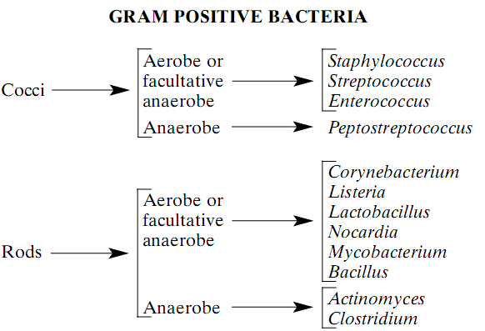
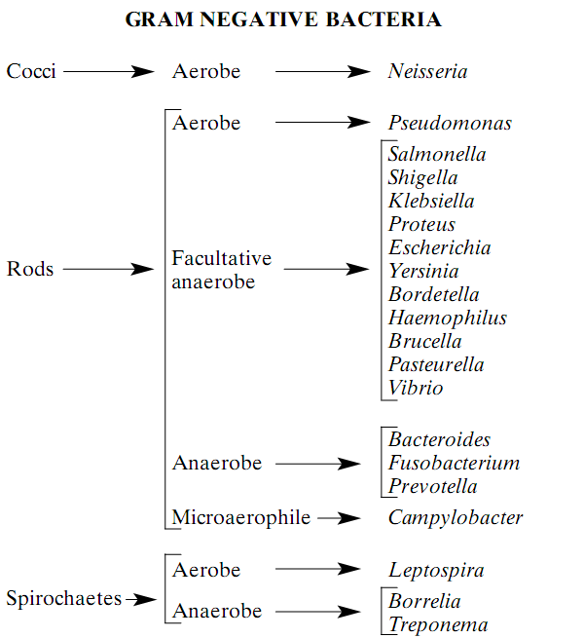

Slide 72
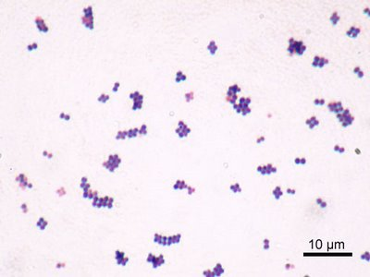
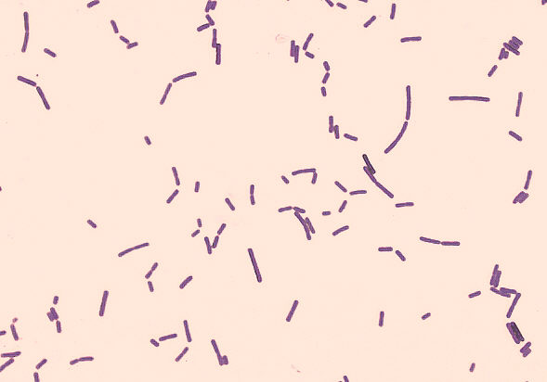
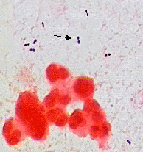
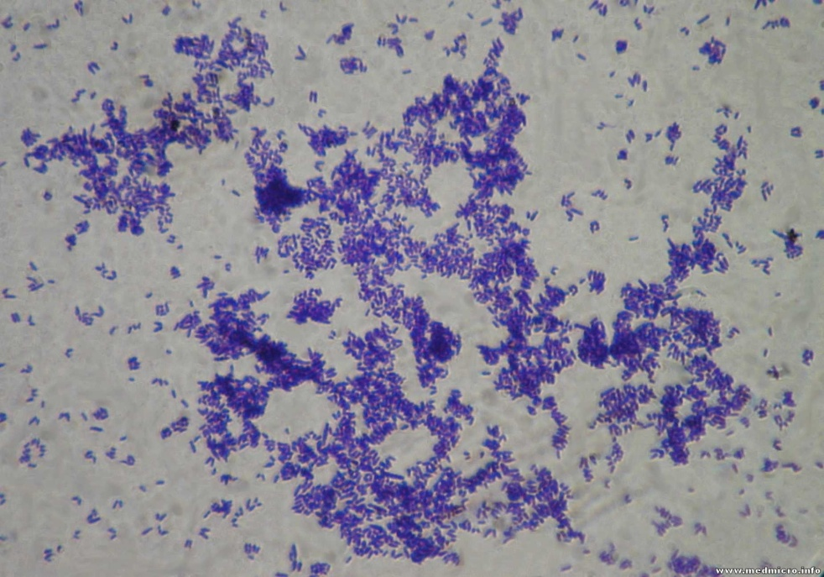
Gram positive cocci
Gram positive rods

Slide 73
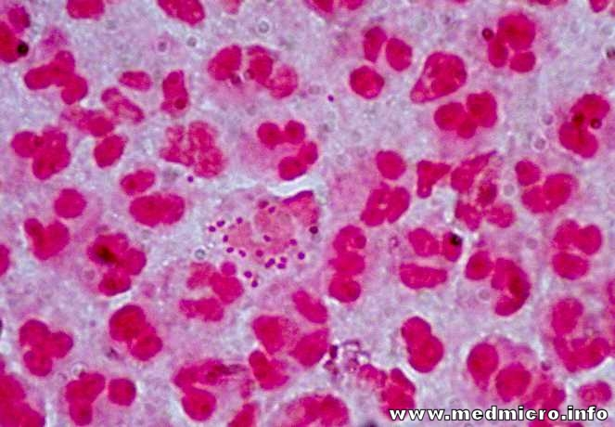
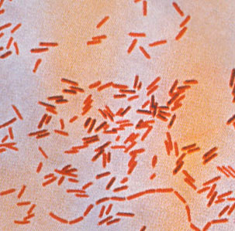
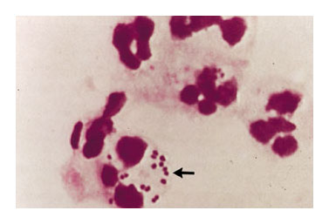
Gram negative rods
Gram negative cocci

Slide 74
2. On the basis of shape (morphology)
Morphology of bacteria includes the major characteistics of bacterial cells such as size, shape, structure and arrangement Morphologically, bacteria can be classified as cocci, rods, spirilla,
Cocci: These are round or oval bacteria measuring about 0.5–1.0 µm in diameter. When multiplying, cocci may form pairs, chains, or irregular groups:–
cocci in pairs are called diplococci, e.g. meningococci and gonococci.
cocci in chains e.g. Streptococcus pyogenes.
cocci in irregular groups e.g. Staphylococcus aureus.
Tetracocci: cluster of four cocci e.g.Micrococcus spp

Slide 75
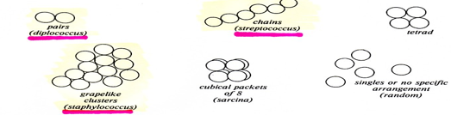

Slide 76
Rods (bacilli): These are stick-like bacteria with rounded, tapered (fusiform), square, or swollen ends.
They measure 1–10 µm in length by 0.3–1.0 µm in width. The short rods with rounded ends are often called coccobacilli. When multiplying, bacterial rods do not usually remain attached to one another, but separate. Occasionally, however, they may:
– form chains, e.g. Streptobacillus species.
– form branching chains, e.g. lactobacilli.
– mass together, e.g. Mycobacterium leprae.
– remain attached at various angles resembling Chinese letters, e.g. Corynebacterium diphtheriae.

Slide 77
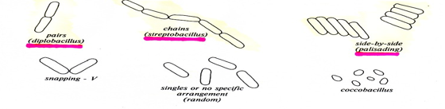

Slide 78
Vibrios: slightly curve rods 3-4 µm by 0.5 µm. Mostly motile with single flagellum e.g. Vibrio cholera
Spirilla: These are small, regularly coiled, rigid organisms measuring about 3–4 µm in length. Spirilla are motile with groups of flagella at both ends. An example of a spirillum is Spirillum minus.
Spirochaetes: These are flexible, coiled, motile organisms. They progress by rapid body movements. Most are not easily stained by the Gram method. Spirochaetes are divided into three main groups:
A.Treponemes:-Thin delicate, regular tight coils 6-15 µm in length and 0.2 µm in width .ex Treponema palladium
B.Borreliae:- large irregular tight coils measuring 10-20µm in length and 0.5 µm in width. Ex Borrelia vincenti
C. Leptospires:-Thin with tightly packed coils that are difficult to distinguish. They measure 6-20µm in length and 0.1 µm in width and have hocked ends. ex.Leptospira interrogans

Slide 79


Slide 80
On the basis of presence and absence of endospore and its location
Spore are metabolically inert form triggered by adverse environmental conditions; adapted for long-term survival, allowing regrowth under suitable conditions. On this basis bacteria can be classified as
spore formers like Bacillus spp, Corynebacterium spp and
non spore formers like E coli. The position of spore can be either: terminal, subterminal or central.

Slide 81
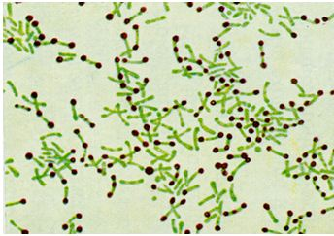

Slide 82
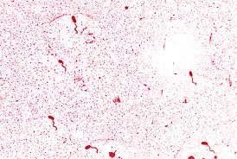
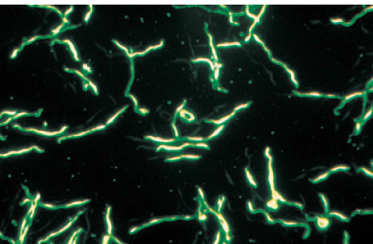
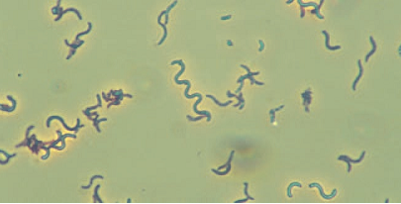

Slide 83
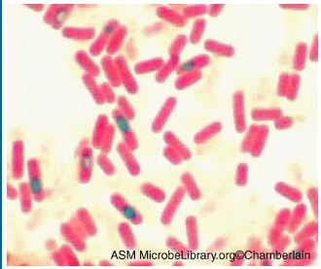

Slide 84
5. On the basis of growth factors
Energy Source:
Chemotroph – such bacteria uses chemical compounds as an energy source (most pathogenic bacteria are chemotrophs.)
Phototroph –such bacteria uses light as energy source
Nutrient Source
Heterotroph –such bacteria derive carbon from preformed organic nutrients such as sugar (most pathogenic bacteria are heterotrophs.)
Autotroph –such bacteria derive carbon from inorganic sources such as carbon dioxide
Electron source
Lithotrophs: such bacteria use reduced inorganic substances as their electron source.
Organotrophs: such bacteria extract electrons from organic compounds

Slide 85
6. On the basis of temperature requirement
In low temperature, membranes solidify and enzymes don’t work whereas in high temperature, enzymes are denatured and disturb transport system. So cells need optimum temperature.
On the basis of temperature requirement, bacteria are classified as;
- Psychrophiles: these bacteria can grow between 0°c-20ºc and has optimum growth temperature of 15°c or more. Eg: Pseudomonas species.
- Mesophiles: these bacteria has temperature range of 2o-45°c. Optmium temp 37 º c almost all human pathogens are mesophiles.
- Thermophiles: Above 45 ºc.These bacteria has optimum temperature of 55-65°c.

Slide 86
7. On the basis of pH
On the basis ofpH, bacteria are classified as;
- Acidophiles: these bacteria has growth optimum pH between pH 0-5.5.
- Neutrophiles: They have optimum pH of 5.5-8.0.
- Alkalophiles: they have optimum pH of 8.5-11.5.
Most bacteria and protozoa are neutrophiles and most fungi prefers slightly acidic environment of about 4-6. Buffers are included in media to prevent growth inhibition by large pH.

Slide 87
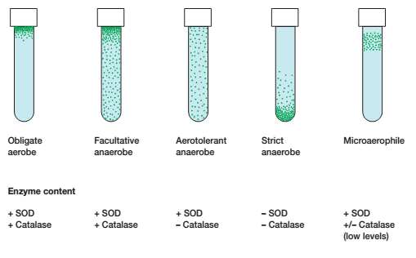
8. On the basis of oxygen requirement.
According to O2 requirement, bacteria can be classified as;
- Aerobes: grows in presence of oxygen. Ex: Pseudomonas sps.
- Anaerobe: grows in absence of oxygen. Ex: Clostridium sps
- Facultative anaerobe: donot require O₂ for growth but do grow better in its presence. Ex: E coli
- Aerotolerant anaerobe: Ignores O₂ and grows equally well whether it is present or not. Ex: Enterococcus faecalis.
- Microaerophilic: requires O₂ below the range of 2-10%. Ex: Helicobacter pylori

Slide 88
Bergey’s Manual of Systematic Bacteriology gives the accepted system of procaryotic taxonomy. Most microbiologists classify bacteria according to a phylogenetic classification system based on Bergey's Manual of Systematic Bacteriology (Bergey's Manual). The Bergey's Manual is a guide to distinguishing bacterial species based on phenotypic differences. gives the accepted system of procaryotic taxonomy
1st edition: features such as cell shape, Gramstaining characteristics, oxygen relationships, motility, and the mode of energy production are used to classify procaryotes.
2nd edition:Comparisons of nucleic acid sequences, particularly 16S rRNA sequences. It has 5 volumes.

